Slide 1
Wireless Networks
Lecture 27
WLAN Part II

Slide 2
Outlines
Last Lecture Review
Problems with DCF
Virtual Carrier Sensing
RTC/CTS Protocol
Interframe Spacing
PCF
Fragmentation / Reassembly
MAC Frame Format
Frame Types
Physical Media in Original IEEE 802.11

Slide 3
Problems with DCF
Hidden Node
A
B
C

Slide 4
Exposed Node problem
A
B
C
D

Slide 5
RTS/CTS Protocol
Virtual Carrier Sense technique.
Source sends Request-to-Send beacon
Destination, if free, sends Clear-to-Send beacon.
Source transmits data packet.
Destination ACKs if receives successfully
RTS
CTS
MDU
ACK
Destination
Source

Slide 6
RTS includes source, destination ID and duration of following transaction.
The duration info allows to protect the transmission from collision on the transmitter side.
The destination response in CTS also includes the same duration amount.
This helps in overcoming hidden terminal problem.
All the stations hearing RTS/CTS set their Network Allocation Vector (NAV) to the given duration.
Since RTS/CTS are shorter frames than MSDU, collision is detected fast.
If MSDU is smaller than RTSThreshold, Standard allows to skip RTS/CTS.

Slide 7
Interframe Spacing
Short interframe space (SIFS)
The SIFS is used for the highest-priority transmissions, such as RTS/CTS frames and positive acknowledgments.
PCF interframe space (PIFS)
The PIFS is used by the PCF during contention-free operation. Stations with data to transmit in the contention-free period can transmit after the PIFS has elapsed and pre-empt any contention-based traffic
DCF interframe space (DIFS)
The DIFS is the minimum medium idle time for contention-based services. Stations may have immediate access to the medium if it has been free for a period longer than the DIFS.
Extended interframe space (EIFS)
The EIFS is not a fixed interval. It is used only when there is an error in frame transmission.

Slide 8
DIFS
SIFS
Sender
RTS
MPDU
SIFS
DIFS
CW
SIFS
CTS
ACK
Next MPDU
Receiver
NAV(RTS)
Other
NAV(CTS)
Backoff after defer
Defer Access

Slide 9
Point Coordination Function
Centralized access to medium.
Implemented on top of DCF.
AP issues polls to the MS on round robin fashion.
PIFS is used between polling.

Slide 11
Fragmentation and Reassembly
In Ethernet, MAC frame can be upto 1518 bytes long.
Not possible to support such larger size of frame because of:
Higher bit error rate
If it is corrupted, large size would incur high overheads.
On FH, medium is interrupted periodically (20ms), smaller packet would result in smaller chance of postponing transmission.

Slide 12
In IEEE 802.11 segmentation/reassembly is added to support Ethernet frames.
Each MSDU is divided into several frames/segments.
All the segments are transmitted after SIFS of ACK reception.
Segments are reassembled to MSDU in the order as transmitted.

Slide 13
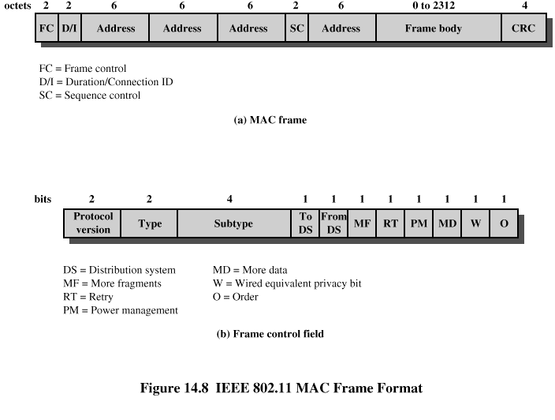
MAC Frame Format

Slide 14
MAC Frame Fields
Frame Control – frame type, control information
Duration/connection ID – channel allocation time
Addresses – context dependant, types include source and destination
Sequence control – numbering and reassembly
Frame body – MSDU or fragment of MSDU
Frame check sequence – 32-bit CRC

Slide 15
Addresses
Destination address
As in Ethernet, the destination address is the 48-bit IEEE MAC identifier that corresponds to the final recipient: the station that will hand the frame to higher protocol layers for processing.
Source address
This is the 48-bit IEEE MAC identifier that identifies the source of the transmission. Only one station can be the source of a frame, so the Individual/Group bit is always 0 to indicate an individual station.
Receiver address
This is a 48-bit IEEE MAC identifier that indicates which wireless station should process the frame. If it is a wireless station, the receiver address is the destination address.
Transmitter address
This is a 48-bit IEEE MAC address to identify the wireless interface that transmitted the frame onto the wireless medium.

Slide 16
Frame Control Fields
Protocol version – 802.11 version
Type – control, management, or data
Subtype – identifies function of frame
To DS – 1 if destined for DS
From DS – 1 if leaving DS
More fragments – 1 if fragments follow
Retry – 1 if retransmission of previous frame
Power management – 1 if transmitting station is in sleep mode
More data – Indicates that station has more data to send
WEP – 1 if wired equivalent protocol is implemented
Order – 1 if any data frame is sent using the Strictly Ordered service

Slide 17
Control Frame Subtypes (Type 01)
Power save – poll (PS-Poll)
Request to send (RTS)
Clear to send (CTS)
Acknowledgment
Contention-free (CF)-end
CF-end + CF-ack

Slide 18
Data Frame Subtypes (Type 10)
Data-carrying frames
Data
Data + CF-Ack
Data + CF-Poll
Data + CF-Ack + CF-Poll
Other subtypes (don’t carry user data)
Null Function
CF-Ack
CF-Poll
CF-Ack + CF-Poll

Slide 19
Management Frame Subtypes (Type 00)
Association request
Association response
Reassociation request
Reassociation response
Probe request
Probe response
Beacon
Announcement traffic indication message
Dissociation
Authentication
Deauthentication

Slide 20
Physical Media Defined by Original 802.11 Standard
Direct-sequence spread spectrum
Operating in 2.4 GHz ISM band
Data rates of 1 and 2 Mbps
Frequency-hopping spread spectrum
Operating in 2.4 GHz ISM band
Data rates of 1 and 2 Mbps
Infrared
1 and 2 Mbps
Wavelength between 850 and 950 nm

Slide 21
IEEE 802.11a and IEEE 802.11b
IEEE 802.11a
Makes use of 5-GHz band
Provides rates of 6, 9 , 12, 18, 24, 36, 48, 54 Mbps
Uses orthogonal frequency division multiplexing (OFDM)
Subcarrier modulated using BPSK, QPSK, 16-QAM or 64-QAM
IEEE 802.11b
Provides data rates of 5.5 and 11 Mbps
Complementary code keying (CCK) modulation scheme

